Slide 1
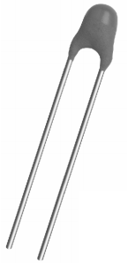
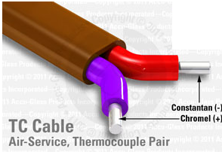
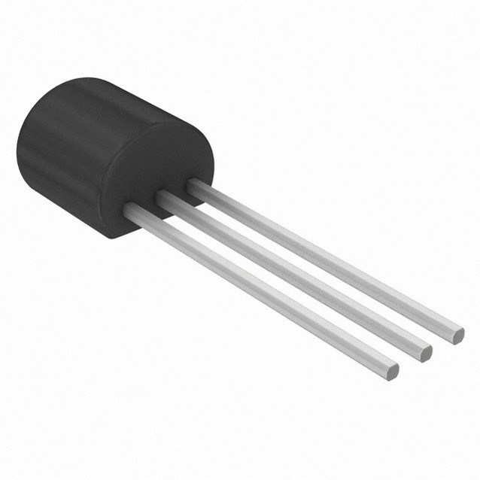
Engineering 80 – Spring 2015 Temperature Measurements
SOURCE: http://www.eng.hmc.edu/NewE80/PDFs/VIshayThermDataSheet.pdf
SOURCE: http://elcodis.com/photos/19/51/195143/to-92-3_standardbody__to-226_straightlead.jpg
SOURCE: http://www.accuglassproducts.com/product.php?productid=17523

Slide 2
Key Concepts
Measuring Temperature
Types of Temperature Sensors
Thermistor
Integrated Silicon Linear Sensor
Thermocouple
Resistive Temperature Detector (RTD)
Choosing a Temperature Sensor
Calibrating Temperature Sensors
Thermal System Transient Response
ENGR 106 Lecture 3
Failure

Slide 3

What is Temperature?
SOURCE: http://www.clker.com/cliparts/6/5/b/f/11949864691020941855smiley114.svg.med.png
ENGINEERING 80
Temperature Measurements

Slide 4
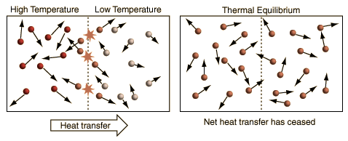
What is Temperature?
units
AN OVERLY SIMPLIFIED DESCRIPTION OF TEMPERATURE
SOURCE: http://hyperphysics.phy-astr.gsu.edu/hbase/thermo/temper2.html#c1
"Temperature is a measure of the tendency of an object to spontaneously give up energy to its surroundings. When two objects are in thermal contact, the one that tends to spontaneously lose energy is at the higher temperature.“
(Schroeder, Daniel V. An Introduction to Thermal Physics, 1st Edition (Ch, 1). Addison-Wesley.)
ENGINEERING 80
Temperature Measurements

Slide 5
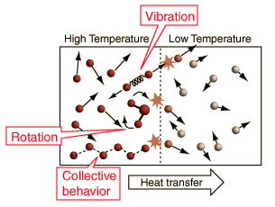
What is Temperature?
units
A SIMPLIFIED DESCRIPTION OF TEMPERATURE
SOURCE: http://hyperphysics.phy-astr.gsu.edu/hbase/thermo/temper2.html#c1
"Temperature is a measure of the tendency of an object to spontaneously give up energy to its surroundings. When two objects are in thermal contact, the one that tends to spontaneously lose energy is at the higher temperature.“
(Schroeder, Daniel V. An Introduction to Thermal Physics, 1st Edition (Ch, 1). Addison-Wesley.)
ENGINEERING 80
Temperature Measurements

Slide 6

Measuring Temperature with Rockets
ENGINEERING 80
Temperature Measurements

Slide 7
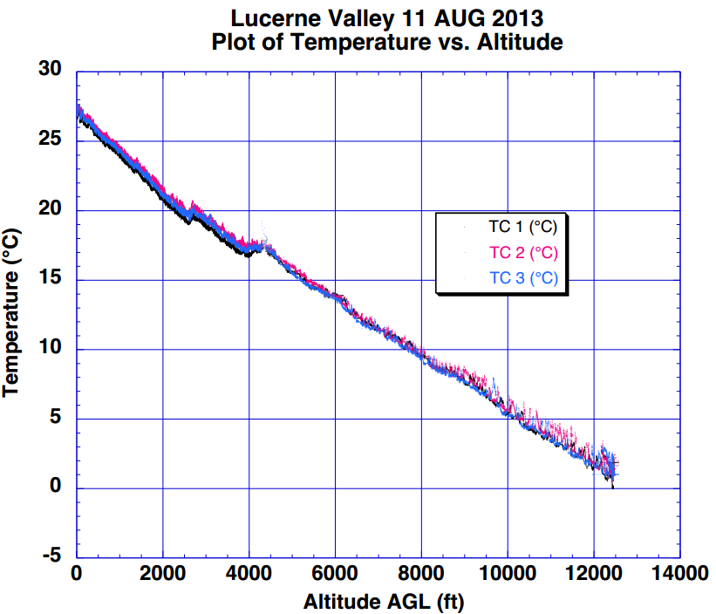
Measuring Temperature with Rockets
What are desirable characteristics of a temperature sensor?
ENGINEERING 80
Temperature Measurements

Slide 8
Desirable Temperature Sensor Characteristics
FAST RESPONSE
ACCURATE
REPEATABLE
EASY CALIBRATION
WIDE TEMPERATURE RANGE
TEMPERATURE SENSOR
COST
SIMPLE RELATIONSHIP
SENSOR OUTPUT → TEMPERATURE
ENGINEERING 80
TEMPERATURE MEASUREMENTS

Slide 9
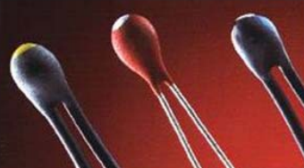
Thermistor
Thermistor – a resistor whose resistance changes with temperature
ENGR 106 Lecture 3
Temperature Measurements

Slide 10
Thermistor
Thermistor – a resistor whose resistance changes with temperature
Resistive element is generally a metal-oxide ceramic containing Mn, Co, Cu, or Ni
Packaged in a thermally conductive glass bead or disk with two metal leads
ENGR 106 Lecture 3
Temperature Measurements

Slide 11
Thermistor
Thermistor – a resistor whose resistance changes with temperature
Resistive element is generally a metal-oxide ceramic containing Mn, Co, Cu, or Ni
Packaged in a thermally conductive glass bead or disk with two metal leads
Suppose we have a “1 kΩ thermistor”…
What does this mean?
ENGR 106 Lecture 3
Temperature Measurements

Slide 12
Thermistor
Thermistor – a resistor whose resistance changes with temperature
Resistive element is generally a metal-oxide ceramic containing Mn, Co, Cu, or Ni
Packaged in a thermally conductive glass bead or disk with two metal leads
Suppose we have a “1 kΩ thermistor” …
What does this mean?
At room temperature, the resistance of the thermistor is 1 kΩ
ENGR 106 Lecture 3
Temperature Measurements

Slide 13
Thermistor
Thermistor – a resistor whose resistance changes with temperature
Resistive element is generally a metal-oxide ceramic containing Mn, Co, Cu, or Ni
Packaged in a thermally conductive glass bead or disk with two metal leads
Suppose we have a “1 kΩ thermistor”
What does this mean?
At room temperature, the resistance of the thermistor is 1 kΩ
What happens to resistance as we increase temperature?
ENGR 106 Lecture 3
Temperature Measurements

Slide 14
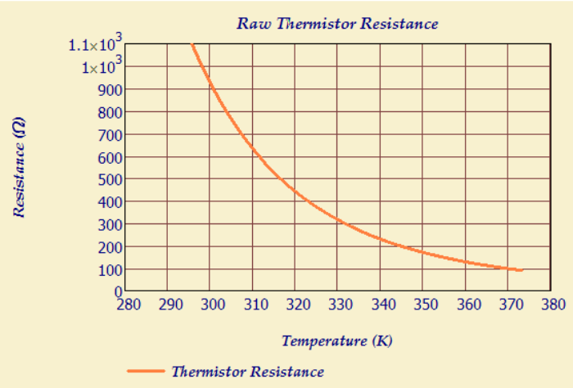
Negative Temperature Coefficient
Most materials exhibit a negative temperature coefficient (NTC)
Resistance drops with temperature!
ENGINEERING 80
Temperature Measurements

Slide 15

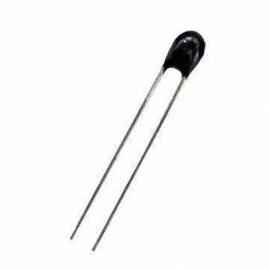
Converting Resistance to Temperature
The Steinhart-Hart Equation relates temperature to resistance
SOURCE: http://p.globalsources.com/IMAGES/PDT/B1055847338/Thermistor.jpg
ENGINEERING 80
Temperature Measurements

Slide 16
Converting Resistance to Temperature
The Steinhart-Hart Equation relates temperature to resistance
T is the temperature (in Kelvin)
R is the resistance at T and R_{ref} is resistance at T_{ref}
A₁, B₁, C₁, and D₁ are the Steinhart-Hart Coefficients
HOW COULD WE DETERMINE THESE COEFFICIENTS?
SOURCE: http://p.globalsources.com/IMAGES/PDT/B1055847338/Thermistor.jpg
ENGINEERING 80
Temperature Measurements

Slide 17
Converting Resistance to Temperature
The Steinhart-Hart Equation relates temperature to resistance
T is the temperature (in Kelvin)
R is the resistance at T and R_{ref} is resistance at T_{ref}
A₁, B₁, C₁, and D₁ are the Steinhart-Hart Coefficients
HOW COULD WE DETERMINE THESE COEFFICIENTS?
Take a look at the data sheet
SOURCE: http://p.globalsources.com/IMAGES/PDT/B1055847338/Thermistor.jpg
ENGINEERING 80
Temperature Measurements

Slide 18
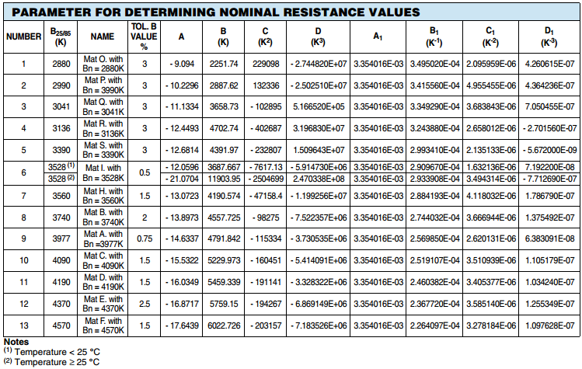
Converting Resistance to Temperature
ENGINEERING 80
Temperature Measurements

Slide 19
Converting Resistance to Temperature
ENGINEERING 80
Temperature Measurements

Slide 20
Converting Resistance to Temperature
WHAT IF YOU LOST THE DATA SHEET, DON’T BELIEVE IT, OR WOULD LIKE TO VERIFY THE VALUES?
ENGINEERING 80
Temperature Measurements

Slide 21
Converting Resistance to Temperature
The Steinhart-Hart Equation relates temperature to resistance
T is the temperature (in Kelvin)
R is the resistance at T and R_{ref} is resistance at T_{ref}
A₁, B₁, C₁, and D₁ are the Steinhart-Hart Coefficients
HOW COULD WE DETERMINE THESE COEFFICIENTS?
Take a look at the data sheet
SOURCE: http://p.globalsources.com/IMAGES/PDT/B1055847338/Thermistor.jpg
ENGINEERING 80
Temperature Measurements

Slide 22
Converting Resistance to Temperature
The Steinhart-Hart Equation relates temperature to resistance
T is the temperature (in Kelvin)
R is the resistance at T and R_{ref} is resistance at T_{ref}
A₁, B₁, C₁, and D₁ are the Steinhart-Hart Coefficients
HOW COULD WE DETERMINE THESE COEFFICIENTS?
Take a look at the data sheet
Measure 3 resistances at 3 temperatures
Matrix Inversion (Linear Algebra)
SOURCE: http://p.globalsources.com/IMAGES/PDT/B1055847338/Thermistor.jpg
ENGINEERING 80
Temperature Measurements

Slide 23
Converting Resistance to Temperature
The Steinhart-Hart Equation relates temperature to resistance
T is the temperature (in Kelvin)
R is the resistance at T and R_{ref} is resistance at T_{ref}
A₁, B₁, C₁, and D₁ are the Steinhart-Hart Coefficients
HOW COULD WE DETERMINE THESE COEFFICIENTS?
Take a look at the data sheet
Measure 3 resistances at 3 temperatures
Matrix Inversion (Linear Algebra)
Least Squares Fit
SOURCE: http://p.globalsources.com/IMAGES/PDT/B1055847338/Thermistor.jpg
ENGINEERING 80
Temperature Measurements

Slide 24
How is Resistance Measured?
SOURCE: http://p.globalsources.com/IMAGES/PDT/B1055847338/Thermistor.jpg
ENGINEERING 80
Temperature Measurements

Slide 25
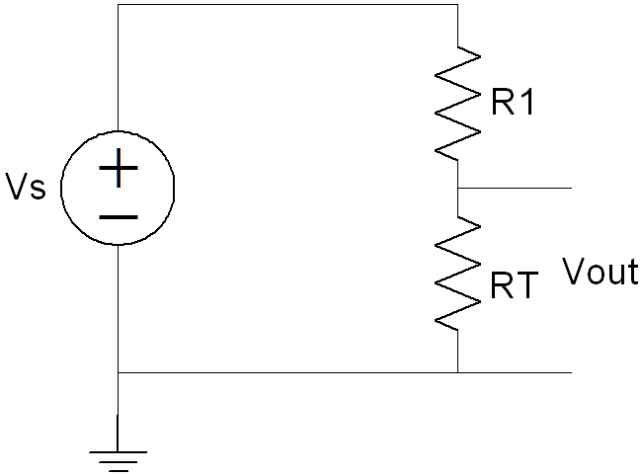

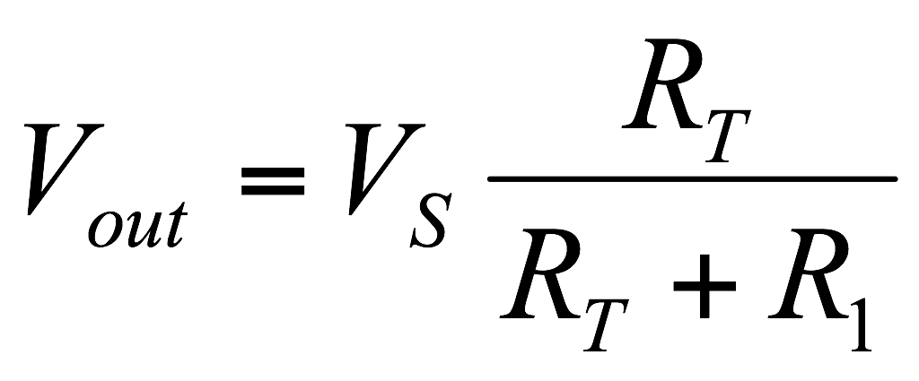


Thermistor Resistance (R_{T})
A thermistor produces a resistance (R_{T}), which must be converted to a voltage signal
ENGINEERING 80
Temperature Measurements

Slide 26
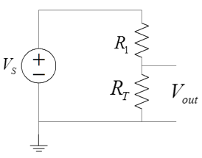
Power Dissipation in Thermistors
A current must pass through the thermistor to measure the voltage and calculate the resistance
The current flowing through the thermistor generates heat because the thermistor dissipates electrical power
P = I²R_{T}
The heat generated causes a temperature rise in the thermistor
This is called Self-Heating
WHY IS SELF-HEATING BAD?
I
ENGINEERING 80
Temperature Measurements

Slide 27
Power Dissipation and Self-Heating
Self-Heating can introduce an error into the measurement
The increase in device temperature (ΔT) is related to the power dissipated (P) and the power dissipation factor (δ)
P = δ ΔT
Where P is in [W], ΔT is the rise in temperature in [ºC]
Suppose I = 5 mA, R_{T} = 4 kΩ, and δ = 0.067 W/ºC, what is ΔT?
ENGINEERING 80
Temperature Measurements

Slide 28
Power Dissipation and Self-Heating
Self-Heating can introduce an error into the measurement
The increase in device temperature (ΔT) is related to the power dissipated (P) and the power dissipation factor (δ)
P = δ ΔT
Where P is in [W], ΔT is the rise in temperature in [ºC]
Suppose I = 5 mA, R_{T} = 4 kΩ, and δ = 0.067 W/ºC, what is ΔT?
(0.005 A)²(4000 Ω) = (0.067 W/ºC) ΔT
ΔT = 1.5 ºC
What effect does a ΔT of 1.5 ºC have on your thermistor measurements?
ENGINEERING 80
Temperature Measurements

Slide 29
Power Dissipation and Self-Heating
Self-Heating can introduce an error into the measurement
The increase in device temperature (ΔT) is related to the power dissipated (P) and the power dissipation factor (δ)
P = δ ΔT
Where P is in [W], ΔT is the rise in temperature in [ºC]
Suppose I = 5 mA, R_{T} = 4 kΩ, and δ = 0.067 W/ºC, what is ΔT?
ENGINEERING 80
Temperature Measurements

Slide 30
Power Dissipation and Self-Heating
Self-Heating can introduce an error into the measurement
The increase in device temperature (ΔT) is related to the power dissipated (P) and the power dissipation factor (δ)
P = δ ΔT
Where P is in [W], ΔT is the rise in temperature in [ºC]
Suppose I = 5 mA, R_{T} = 4 kΩ, and δ = 0.067 W/ºC, what is ΔT?
(0.005 A)²(4000 Ω) = (0.067 W/ºC) ΔT
ΔT = 1.5 ºC
What effect does a ΔT of 1.5 ºC have on your thermistor measurements?
How can we reduce the effects of self-heating?
Increase the resistance of the thermistor!
ENGINEERING 80
Temperature Measurements

Slide 31
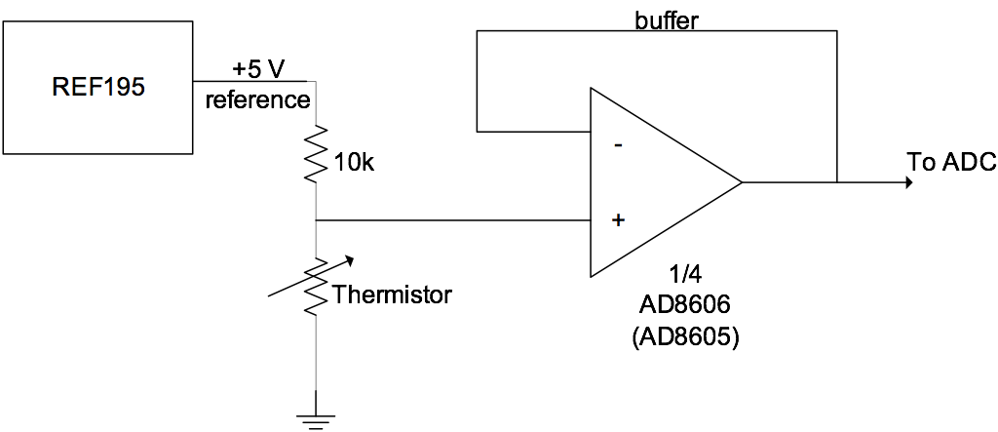
Thermistor Signal Conditioning Circuit
A voltage divider and a unity gain buffer are required to measure temperature in the lab
ENGINEERING 80
Temperature Measurements

Slide 32
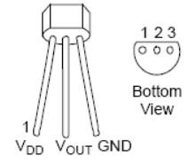
Integrated Silicon Linear Sensors
An integrated silicon linear sensor is a three-terminal device
Power and ground inputs
Relatively simple to use and cheap
Circuitry inside does linearization and signal conditioning
Produces an output voltage linearly dependent on temperature
3.1 – 5.5 V
ENGINEERING 80
Temperature Measurements

Slide 33
Integrated Silicon Linear Sensors
An integrated silicon linear sensor is a three-terminal device
Power and ground inputs
Relatively simple to use and cheap
Circuitry inside does linearization and signal conditioning
Produces an output voltage linearly dependent on temperature
When compared to other temperature measurement devices, these sensors are less accurate, operate over a narrower temperature range, and are less responsive
Vout = Vref + (Tm-Tref)Vsens
3.1 – 5.5 V
ENGINEERING 80
Temperature Measurements

Slide 34
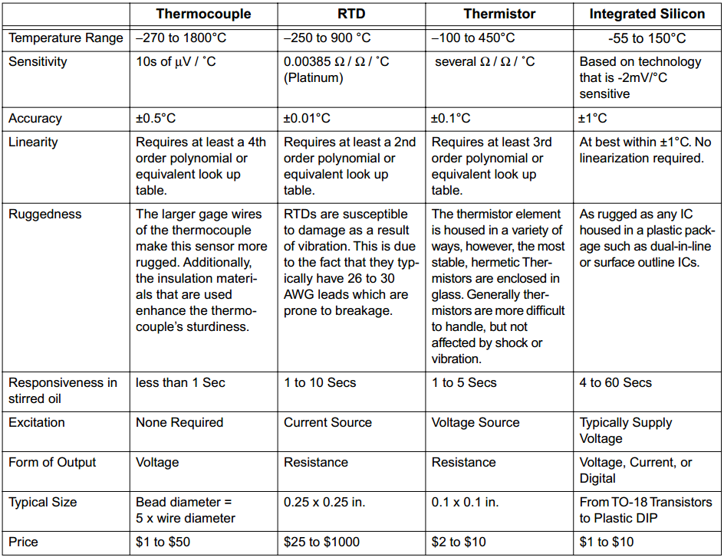
Summary Thus Far…
>
ENGINEERING 80
Temperature Measurements

Slide 35

Thermocouple
Thermocouple – a two-terminal element consisting of two dissimilar metal wires joined at the end
SOURCE: http://upload.wikimedia.org/wikipedia/en/e/ed/Thermocouple_(work_diagram)_LMB.png
ENGINEERING 80
Temperature Measurements

Slide 36
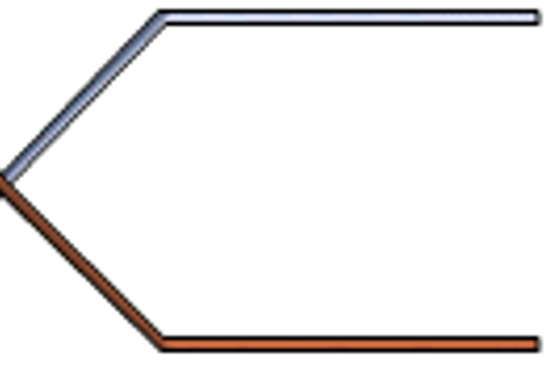

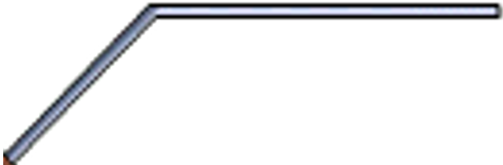
The Seebeck Effect
Seebeck Effect – A conductor generates a voltage when it is subjected to a temperature gradient
ENGINEERING 80
Temperature Measurements

Slide 37
The Seebeck Effect
Seebeck Effect – A conductor generates a voltage when it is subjected to a temperature gradient
Measuring this voltage requires the use of a second conductor material
Nickel-Chromium Alloy
Will I observe a difference in voltage at the ends of two wires composed of the same material?
Nickel-Chromium Alloy
ENGINEERING 80
Temperature Measurements

Slide 38
The Seebeck Effect
Seebeck Effect – A conductor generates a voltage when it is subjected to a temperature gradient
Measuring this voltage requires the use of a second conductor material
The other material needs to be composed of a different material
Nickel-Chromium Alloy
The relationship between temperature difference and voltage varies with materials
Copper-Nickel Alloy
ENGINEERING 80
Temperature Measurements

Slide 39
The Seebeck Effect
Seebeck Effect – A conductor generates a voltage when it is subjected to a temperature gradient
Measuring this voltage requires the use of a second conductor material
The other material needs to be composed of a different material
Nickel-Chromium Alloy
+
The relationship between temperature difference and voltage varies with materials
The voltage difference of the two dissimilar metals can be measured and related to the corresponding temperature gradient
V_{S} = SΔT
-
Copper-Nickel Alloy
ENGINEERING 80
Temperature Measurements

Slide 40
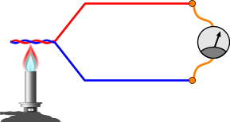
Measuring Temperature
To measure temperature using a thermocouple, you can’t just connect the thermocouple to a measurement system (e.g. voltmeter)
SOURCE: http://www.pcbheaven.com/wikipages/images/thermocouples_1271330366.png
ENGINEERING 80
Temperature Measurements

Slide 41
Measuring Temperature
To measure temperature using a thermocouple, you can’t just connect the thermocouple to a measurement system (e.g. voltmeter)
The voltage measured by your system is proportional to the temperature difference between the primary junction (hot junction) and the junction where the voltage is being measured (Ref junction)
SOURCE: http://www.pcbheaven.com/wikipages/images/thermocouples_1271330366.png
ENGINEERING 80
Temperature Measurements

Slide 42
Measuring Temperature
To measure temperature using a thermocouple, you can’t just connect the thermocouple to a measurement system (e.g. voltmeter)
The voltage measured by your system is proportional to the temperature difference between the primary junction (hot junction) and the junction where the voltage is being measured (Ref junction)
To determine the absolute temperature at the hot junction…
You need to know the temperature at the Ref junction!
SOURCE: http://www.pcbheaven.com/wikipages/images/thermocouples_1271330366.png
ENGINEERING 80
Temperature Measurements

Slide 43
Measuring Temperature
To measure temperature using a thermocouple, you can’t just connect the thermocouple to a measurement system (e.g. voltmeter)
The voltage measured by your system is proportional to the temperature difference between the primary junction (hot junction) and the junction where the voltage is being measured (Ref junction)
To determine the absolute temperature at the hot junction…
You need to know the temperature at the Ref junction!
How can we determine the temperature at the reference junction?
SOURCE: http://www.pcbheaven.com/wikipages/images/thermocouples_1271330366.png
ENGINEERING 80
Temperature Measurements

Slide 44
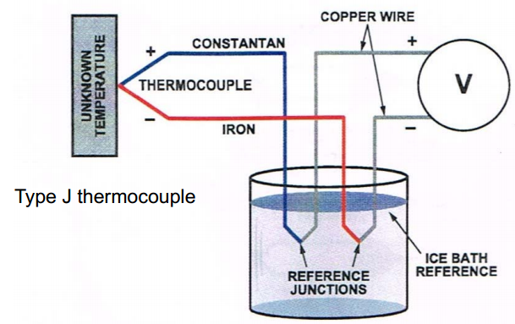
Ice Bath Method (Forcing a Temperature)
Thermocouples measure the voltage difference between two points
To know the absolute temperature at the hot junction, one must know the temperature at the Ref junction
ENGINEERING 80
Temperature Measurements

Slide 45
Ice Bath Method (Forcing a Temperature)
Thermocouples measure the voltage difference between two points
To know the absolute temperature at the hot junction, one must know the temperature at the Ref junction
NIST (National Institute of Standards and Technology) thermocouple reference tables are generated with T_{ref} = 0 ºC
V_{meas} = V(T_{hot}) – V(T_{ref})
V(V_{hot}) = V_{meas} + V(T_{ref})
If we know the voltage-temperature relationship of our thermocouple, we could determine the temperature at the hot junction
IS IT REALLY THAT EASY?
ENGINEERING 80
Temperature Measurements

Slide 46
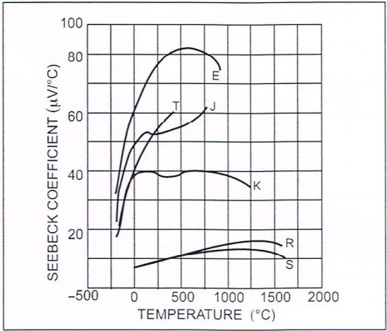
Nonlinearity in the Seebeck Coefficient
V_{S} = SΔT
Thermocouple output voltages are highly nonlinear
The Seebeck coefficient can vary by a factor of 3 or more over the operating temperature range of the thermocouples
ENGINEERING 80
Temperature Measurements

Slide 47
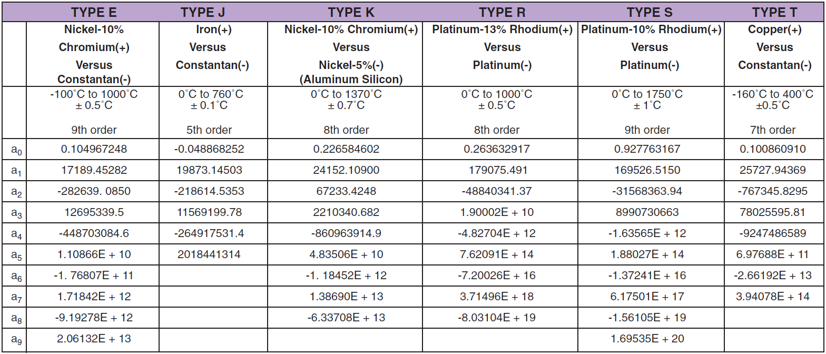
Temperature Conversion Equation
T = a₀ + a₁V + a₂V² + …. + a_{n}V^{n}
ENGINEERING 80
Temperature Measurements

Slide 48
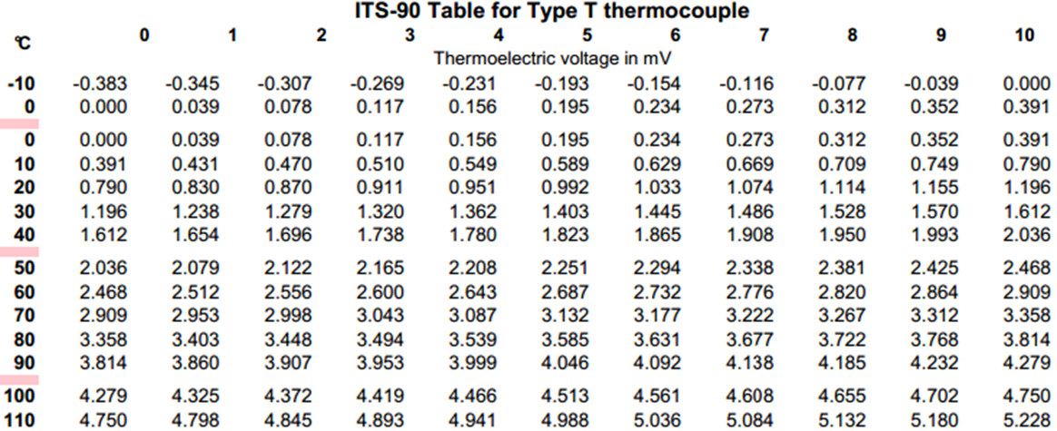
Look-Up Table for a Type T Thermocouple
Voltage difference of the hot and cold junctions: V_{D} = 3.409 mV
What is the temperature of the hot junction if the cold junction is at 22 ºC?
ENGINEERING 80
Temperature Measurements

Slide 49
Look-Up Table for a Type T Thermocouple
Voltage difference of the hot and cold junctions: V_{D} = 3.409 mV
What is the temperature of the hot junction if the cold junction is at 22 ºC?
At 22 ºC, the reference junction voltage is 0.870 mV
The hot junction voltage is therefore 3.409 mV + 0.870 mV = 4.279 mV
The temperature at the hot junction is therefore 100 ºC
ENGINEERING 80
Temperature Measurements

Slide 50
APPLYING WHAT WE’VE LEARNED
Voltage difference of the hot and cold junctions: V_{D} = 4.472 mV
What is the temperature of the hot junction if the cold junction is at –5 ºC?
ENGINEERING 80
Temperature Measurements

Slide 51
APPLYING WHAT WE’VE LEARNED
Voltage difference of the hot and cold junctions: V_{D} = 4.472 mV
What is the temperature of the hot junction if the cold junction is at –5 ºC?
At -5 ºC, the cold junction voltage is –0.193 mV
The hot junction voltage is therefore 4.472 mV – 0.193 mV = 4.279 mV
The temperature at the hot junction is therefore 100 ºC
ENGINEERING 80
Temperature Measurements

Slide 52
Is This Really Practical For a Rocket?
What is another method of determining the temperature at the reference junction?
ENGINEERING 80
Temperature Measurements

Slide 53
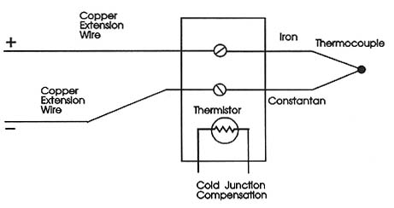
Cold Junction Compensation
SOURCE: http://www.industrial-electronics.com/DAQ/images/10_13.jpg
ENGINEERING 80
Temperature Measurements

Slide 54
Cold Junction Compensation
How could I determine the temperature of the block?
SOURCE: http://www.industrial-electronics.com/DAQ/images/10_13.jpg
ENGINEERING 80
Temperature Measurements

Slide 55
Cold Junction Compensation
SOURCE: http://www.industrial-electronics.com/DAQ/images/10_13.jpg
ENGINEERING 80
Temperature Measurements

Slide 56
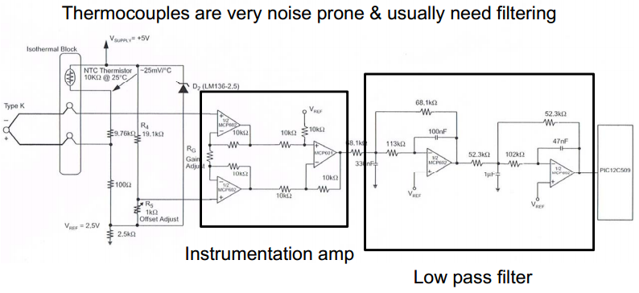
Acquiring Data
ENGINEERING 80
Temperature Measurements

Slide 57
Temperature Measurement Devices in Lab
>
ENGINEERING 80
Temperature Measurements

Slide 58
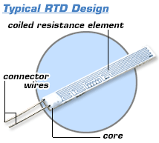
Resistive Temperature Detector (RTD)
Two terminal device
Usually made out of platinum
Positive temperature coefficient
Tends to be linear
R = R₀(1+α)(T-T₀) where T₀ = 0ºC
R₀ = 100 Ω, α = 0.03385 Ω/ Ω ºC
At 10ºC, R = 100(1+0.385)(10) = 103.85 Ω
They are best operated using a small constant current source
Accuracy of 0.01 ºC
EXPENSIVE!
SOURCE: http://www.omega.com/prodinfo/images/RTD_diag1.gif
ENGINEERING 80
Temperature Measurements

Slide 59
Temperature Measurement Devices
>
ENGINEERING 80
Temperature Measurements

Slide 60
How Do I Know If These Are Working?
SOURCE: http://www.eng.hmc.edu/NewE80/PDFs/VIshayThermDataSheet.pdf
SOURCE: http://elcodis.com/photos/19/51/195143/to-92-3_standardbody__to-226_straightlead.jpg
SOURCE: http://www.accuglassproducts.com/product.php?productid=17523
ENGINEERING 80
Temperature Measurements

Slide 61
Calibration
How could we calibrate a temperature sensor?
ENGINEERING 80
Temperature Measurements

Slide 62

Calibration
How could we calibrate a temperature sensor?
0 ºC
25 ºC
100 ºC
ENGINEERING 80
Temperature Measurements

Slide 63
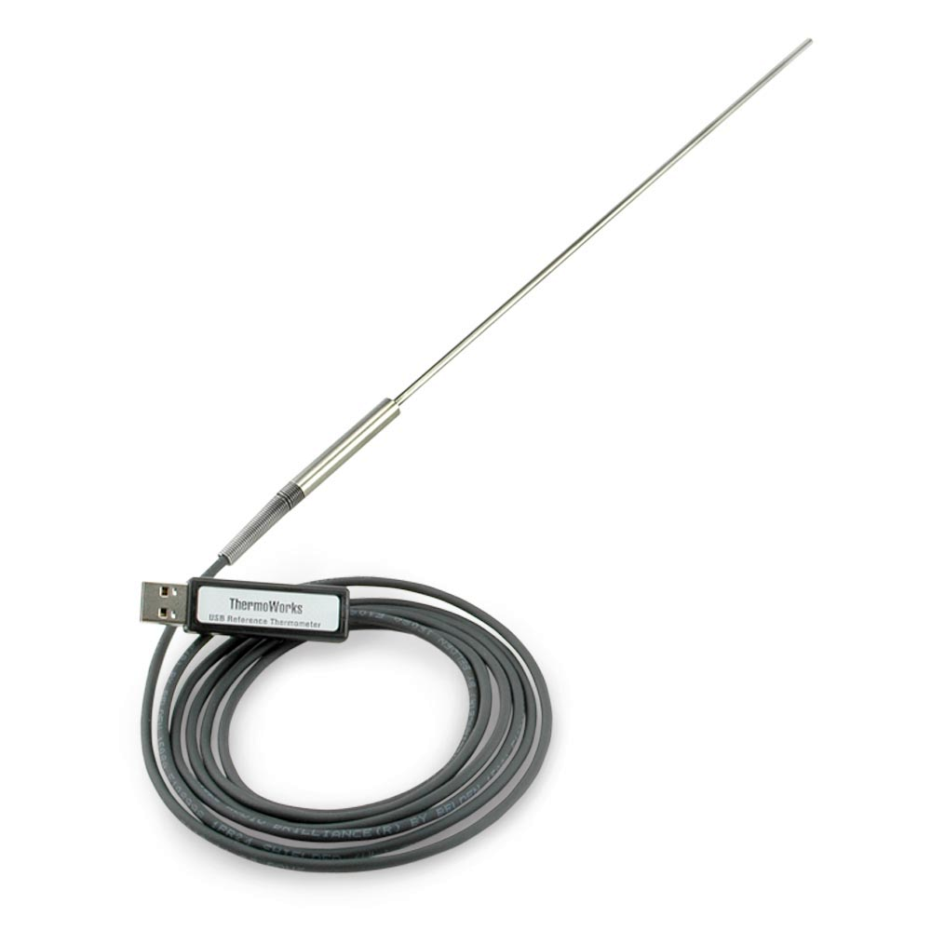
Calibration
USB Reference Thermometer
How could we calibrate a temperature sensor?
SOURCE: http://www.thermoworks.com/products/calibration/usb_reference.html
0 ºC
25 ºC
100 ºC
ENGINEERING 80
Temperature Measurements

Slide 64
Calibration
Each probe includes an individual NIST-Traceable calibration certificate with test data at 0, 25, 70, and 100°C.
How could we calibrate a temperature sensor?
SOURCE: http://www.thermoworks.com/products/calibration/usb_reference.html
0 ºC
25 ºC
100 ºC
ENGINEERING 80
Temperature Measurements

Slide 65
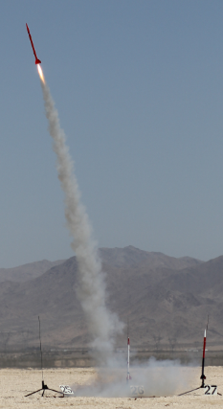
Tracking the Rate of Temperature Change
If a slow sensor is placed into a rocket that is launched to a high altitude, the sensor may not be able to track the rate of temperature change
A critical property of a temperature-measurement device is how quickly it responds to a change in external temperature
ENGINEERING 80
Temperature Measurements

Slide 66
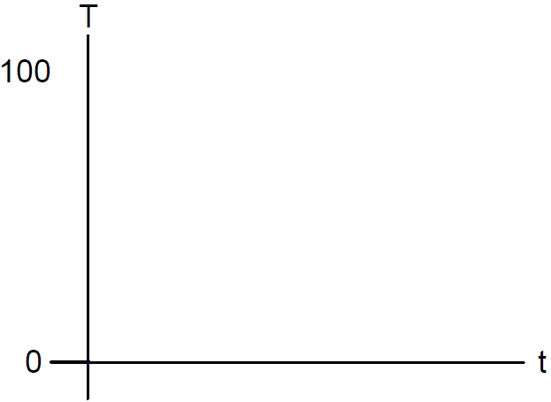


Thermal System Step Response
ENGINEERING 80
Temperature Measurements

Slide 67
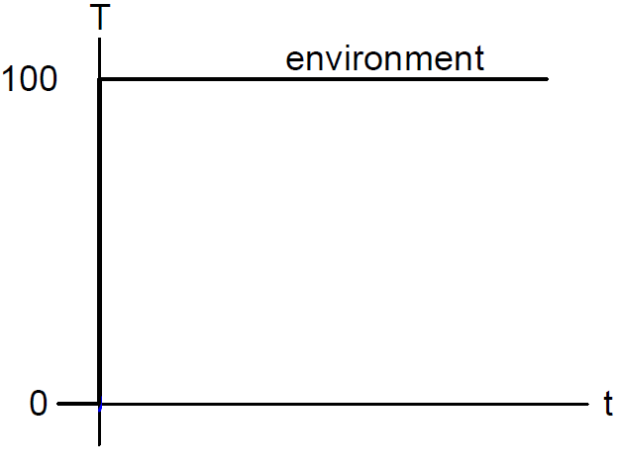
Thermal System Step Response
ENGINEERING 80
Temperature Measurements

Slide 68
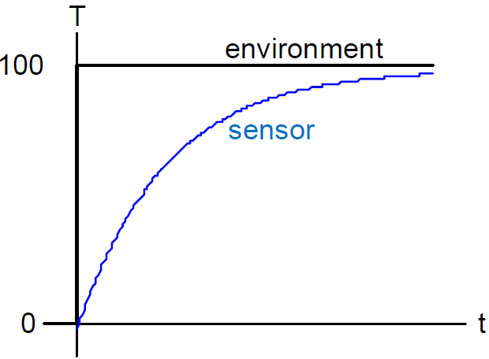
Thermal System Step Response
ENGINEERING 80
Temperature Measurements

Slide 69
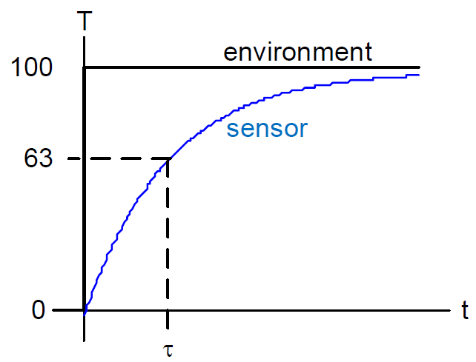
Thermal System Step Response
ENGINEERING 80
Temperature Measurements

Slide 70
Thermal System Step Response
The thermal time constant can be measured as the time it takes to get to (1/e) of the final temperature
100 (1-(1/e)) = 63 ºC
Thermal Time Constant
ENGINEERING 80
Temperature Measurements

Slide 71

Thermal System Step Response
The thermal time constant can be measured as the time it takes to get to (1/e) of the final temperature
100 (1-(1/e)) = 63 ºC
Thermal Time Constant
ENGINEERING 80
Temperature Measurements

Slide 72

Thermal System Step Response
http://www.eng.hmc.edu/NewE80/PDFs/TemperatureMeasurementLecNotes.pdf
http://www.colorado.edu/MCEN/Measlab/background1storder.pdf
http://www.eng.hmc.edu/NewE80/PDFs/TemperatureMeasurementLecNotes.pdf
ENGINEERING 80
Temperature Measurements

Slide 73
SUMMARY
Measuring Temperature
Types of Temperature Sensors
Thermistor
Integrated Silicon Linear Sensor
Thermocouple
Resistive Temperature Detector (RTD)
Choosing a Temperature Sensor
Calibrating Temperature Sensors
Thermal System Transient Response
ENGR 106 Lecture 3
Failure

Slide 74
References
Previous E80 Lectures and Lecture Notes
http://www.eng.hmc.edu/NewE80/TemperatureLec.html
Thermcouples White Paper
http://www.ohio.edu/people/bayless/seniorlab/thermocouple.pdf (downloaded 02/04/2015)
University of Cambridge Thermoelectric Materials for Thermocouples
http://www.msm.cam.ac.uk/utc/thermocouple/pages/ThermocouplesOperatingPrinciples.html (viewed 02/04/2015)
National Instruments Temperature Measurements with Thermocouples: How-To Guide
http://www.technologyreview.com/sites/default/files/legacy/temperature_measurements_with_thermocouples.pdf (downloaded 02/04/2015)
Vishay NTCLE100E3104JB0 Data Sheet
http://www.eng.hmc.edu/NewE80/PDFs/VIshayThermDataSheet.pdf (downloaded on 02/04/2015)
ENGINEERING 80
Temperature Measurements

